Slide 1
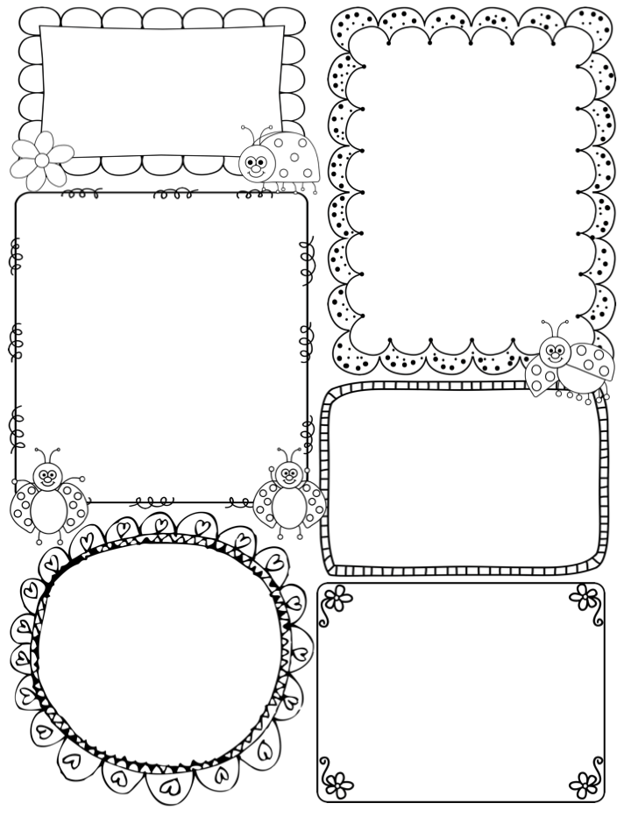
Massey News
Term 1, Week 1
Just for your information
Children will rotate seats until I feel the mix is just right. Don’t be alarmed if they tell you they have been moved!
News books stay in the Reader Bag until we need them again.
Please transfer notes and dates to your own planners.
Students have a pigeon hole to keep their diaries.
Lunches are kept in bags unless the sign is on the door stating to bring them inside due to weather.
Welcome to Year 1 Massey!
I hope you had a lovely holiday and are ready for a busy year. I have been working hard to plan an exciting year of learning and look forward to getting to know you and your child.
Thank you this morning for making the transition easy for your child. Everything ran smoothly, with minimal stress on you and your child. We organised books and stationery throughout the day, without the rush.
Can I stress that students arrive before the bell which rings at 8.45. Lessons begin at 8.50 and students need to be ready, signed in, focused and on the carpet before then. My door opens at 8.35 – 8.40 each day.
Parents, please leave quickly and in an
orderly fashion as it can make the
transition hard for some students.
Our Website
I have also created a website which will be updated periodically with all the newsletters, spelling words, show and tell lists, educational links, timetables and contact details.
It is also a fantastic resource if you have lost information from newsletters etc. Check it out ☺
The address is : year1massey.weebly.com
Weekly Routine
PE – Fridays with Mrs H
Music – Wednesdays with Mrs H
Geography – Fridays with Mrs H
History – Tuesdays with Mrs H
CL – Fridays with Mrs H
Library – Tuesdays with Mrs Sulser
Wipe Out Waste - Wednesday
Important Dates
Parent Information Night – Feb 8th
(I strongly encourage you to attend, as there will be many important facets of your child’s learning and organisational structures explained.)
Trinity Open Day – April 10th
Pupil Free Day – March 18th
Easter Sunday – March 27th
End of Term 1 – Thursday April 15th

Slide 2
Massey News
Term 1, Week 1
Statutory Declarations
If you are interested in helping in the classroom or on excursions / incursions, you must have a Statutory Declaration signed by the principal, Mrs Karen McMahon.
Session 1- Prior to the Junior School information nights - in the Blakeview gym - strictly from 5:30pm-6.00pm to ensure a prompt start for the Information Nights.
Session 2- Tuesday, February 9 from 9am until 10am in the Junior School Activity room.
Session 3- Thursday, February 11 from 3:30pm until 4:30pm in the Junior School Activity Room.
2.
Things to do ….
Please sign the diary on pages 15 and 16, there are 2 school policies that MUST be signed by YOU and YOUR CHILD. They are the Sports Policy and the Internet and Computer Use Policy. These need to be signed and noted by Friday of Week 1.
Please bring in an appropriate waterproof art smock for ART. Other art smocks are OK but sometimes paint seeps through the material leaving a mess on the uniforms. The water proof smocks can be purchased from Starplex. Please bring these in by Week 2, labelled and
pop them in the ART smock tub.
Readers
Readers will be rolled out by the end of Week 1. They may be on a different level to what you expect, do not worry! This is due to how much knowledge they retained over the holidays.
When you get your child’s readers, please help them to change them when necessary.
They should be changing their own readers by Week 4.
FUZZIES
Students will come home talking about FUZZIES. They are my reward system and students love them ☺
They collect FUZZIES for good behavior, effort and work.
They can also loose them.
10 FUZZIES = 1 reward.
Rewards can be used at any time.
I look forward to chatting to you all more about them at our Parent Information Evening,
Spelling
Term 1, Students will receive their words weekly. Weekly spelling testing begins Week 2 and then each week. I will not be testing just the spelling words on test weeks, but the sound. I will explain more at the Info Night session.
Spelling test days are Thursdays.
Try and find time to make their Spelling homework FUN ☺
It makes a HUGE difference.

